Slide 1
Competitive Programming
21 Apr. 2023
Andrei Novikov

Slide 2
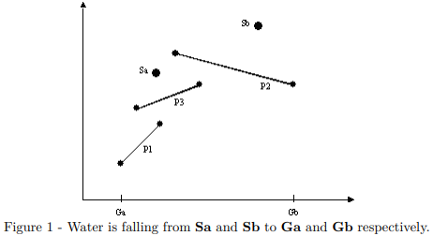
Computational Geometry – 1D Objects
Problem example:
Find the coordinate on the ground where waterfall will be.
Waterfall is vertical segment
Obstacle are segments
Intersection between segments

Slide 3

Computational Geometry - Lines
Line is described by the equation: $ax+by+c=0$
a – defines slop;
b – defines whether line is vertical – two possible values:
0.0 – vertical line;
1.0 – non-vertical;

Slide 4

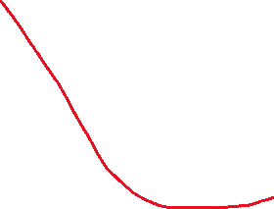

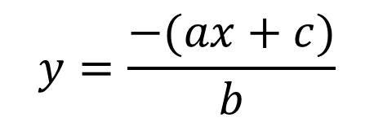
Computational Geometry - Lines
Line is described by the equation: $ax+by+c=0$
a – defines slop;
b – defines whether line is vertical – two possible values:
0.0 – vertical line;
1.0 – non-vertical;
$$y=\frac{−(ax+c)}{b}$$
Special case when the line is vertical
Line representation

Slide 5

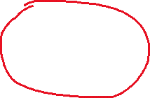
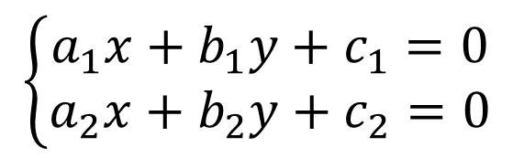


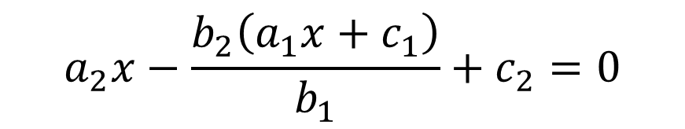
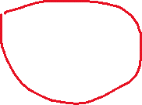
Computational Geometry – Intersection
To find intersection of two line we need to solve linear system:
$$\left\{\begin{aligned}a_{1}x+b_{1}y+c_{1}=0 \\ a_{2}x+b_{2}y+c_{2}=0\end{aligned}\right.$$
$$y=\frac{−(a_{1}x+c_{1})}{b_{1}}$$
$$a_{2}x−\frac{b_{2}\left(a_{1}x+c_{1}\right)}{b_{1}}+c_{2}=0$$
$$x=\frac{b_{1}c_{1}−c_{2}b_{1}}{a_{2}b_{1}−a_{1}b_{2}}$$

Slide 6



Computational Geometry – Intersection
$$x=\frac{b_{1}c_{1}−c_{2}b_{1}}{a_{2}b_{1}−a_{1}b_{2}}$$
Having these formulas lets write function:
$$y=\frac{−(a_{1}x+c_{1})}{b_{1}}$$

Slide 7
Computational Geometry – Intersection
$$x=\frac{b_{1}c_{1}−c_{2}b_{1}}{a_{2}b_{1}−a_{1}b_{2}}$$
Having these formulas lets write function:
$$y=\frac{−(a_{1}x+c_{1})}{b_{1}}$$
What if they are parallel?
What if one of them vertical?

Slide 8


Computational Geometry – Parallel
To check if lines are parallel, we need to consider slop and b:
$$ax+by+c=0$$

Slide 9
Computational Geometry – Intersection
Lets update our function:

Slide 10
Computational Geometry – Line the Same?
The last function that we might need is to check if two lines are the same.
We need to compare parameters of two lines:

Slide 11
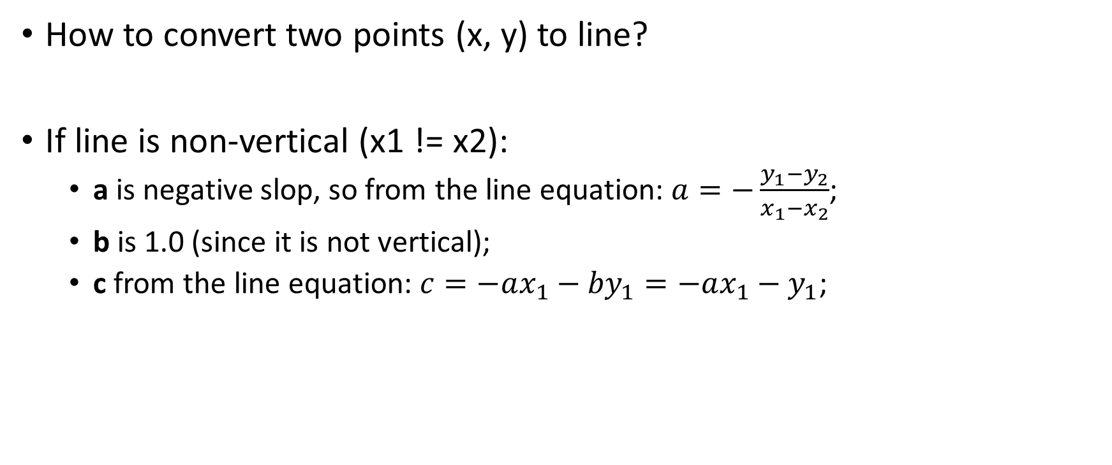
Computational Geometry – Points to Line
How to convert two points (x, y) to line?
If line is non-vertical (x1 != x2):
a is negative slop, so from the line equation: $a=−\frac{y_{1}−y_{2}}{x_{1}−x_{2}}$;
b is 1.0 (since it is not vertical);
c from the line equation: $c=−ax_{1}−{by}_{1}=−ax_{1}−y_{1}$;

Slide 12
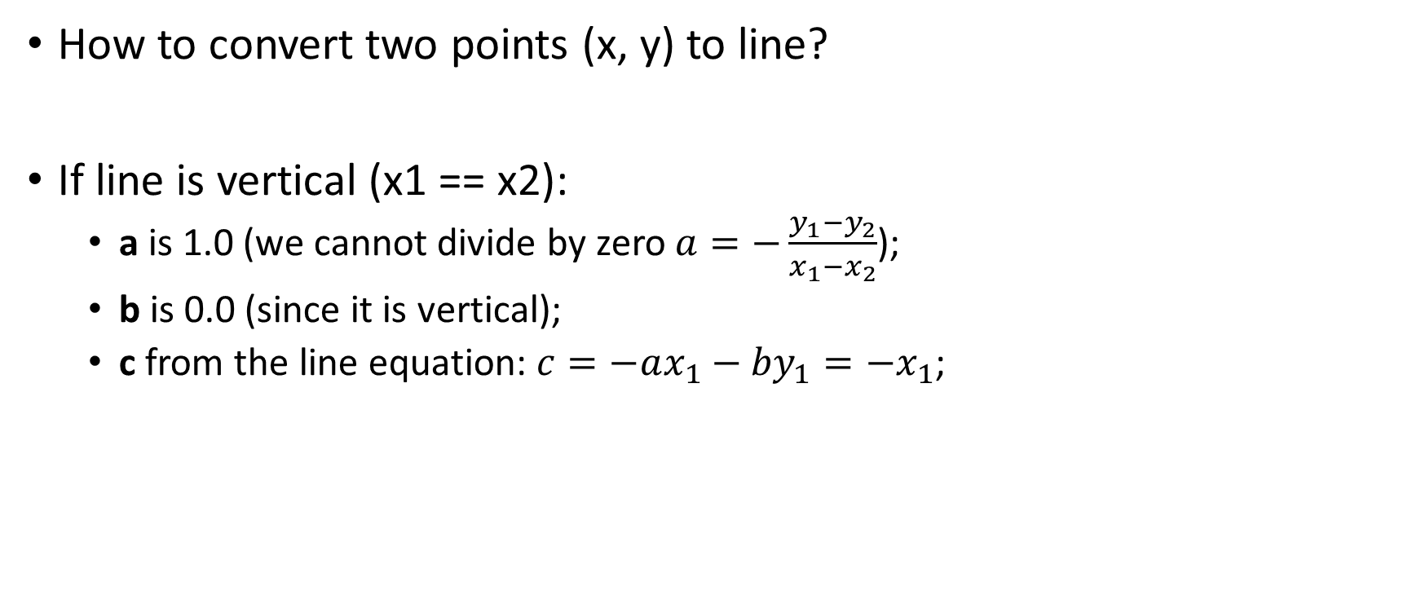
Computational Geometry – Points to Line
How to convert two points (x, y) to line?
If line is vertical (x1 == x2):
a is 1.0 (we cannot divide by zero $a=−\frac{y_{1}−y_{2}}{x_{1}−x_{2}}$);
b is 0.0 (since it is vertical);
c from the line equation: $c=−ax_{1}−{by}_{1}=−x_{1}$;

Slide 13
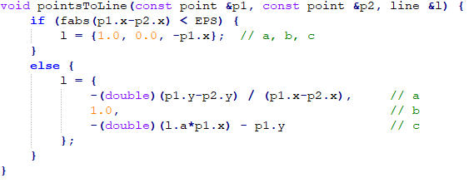
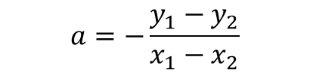

Computational Geometry – Points to Line
How to convert two points (x, y) to line?
$$a=−\frac{y_{1}−y_{2}}{x_{1}−x_{2}}$$
$$c=−ax_{1}−{by}_{1}$$

Slide 14
Computational Geometry – Segments
In segments intersection is needed, then we need to get point of intersection of two lines and then check if the point of intersection within (x1, x2), (y1, y2) borders.

Slide 15
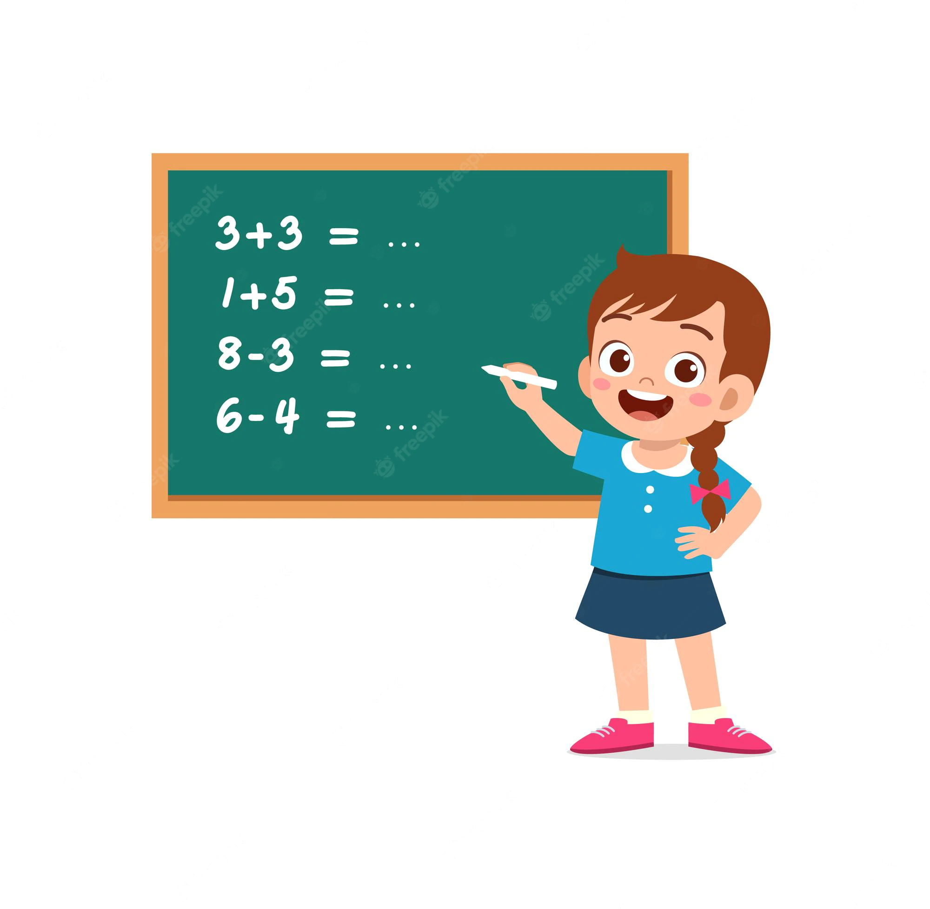
Practice
Kattis – Platforme
Topic: Lines
Link: Link to the Task

Slide 16
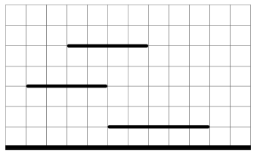


Practice - Approach
Complexity: O(N^2)
For each platform:
For each vertical line on the platforms edge:
Check intersection with all other platform + ground:
Select the closest one that goes down.
Update total length.

Slide 17
New Book
Competitive Programming 4:
Split into two volumes. The second volume is big addition to the 3rd edition (see chapter 8 and 9).
A lot of links to Kattis instead of UVa.

Slide 18
Homework
Competitive Programming 4:
Theory from Chapter 7.2.2;
Practice:
Kattis – Hurricane Danger! – Link;
Kattis – Unlock Pattern – Link;
Kattis – Counting Triangles – Link;
Kattis – Goat Rope – Link;
Kattis – White Water Rafting – Link;
The next session 2023.05.05

Slide 19
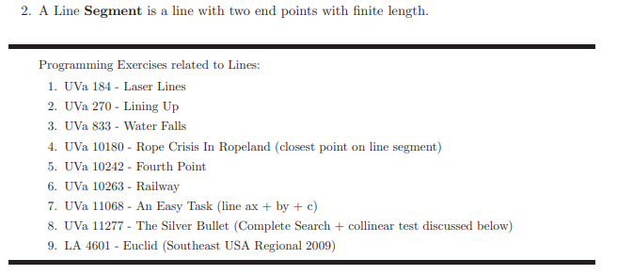

Homework – If You Want More
The tasks about Lines and Segments:
We solved it the last time

